Slide 1

Data55:
Richard, Anneke, Brendan,
Sara, Brenton, Saini and Aditya

Slide 2
Overview - Stories assigned to Sprint 2
Teacher - Accept Student
Student - View Lesson Information
Student - Hire an Instrument
Manager - Return Instruments
Manager - View Hire Requests
Student - Request Specific Teacher
Owner - Register Managers
Student - See Borrowed Instrument Details
Student - View Instrument Hire History
Manager - Deactivate Teacher Accounts

Slide 3
Additional Work/Requested Features After Sprint 1 Preview
Emailing
Dynamic Nav
Account Restrictions on each page
Adding New Instrument Types

Slide 4
Overview - Issues and Considerations
Sprint 2 went much better than Sprint 1.
Notable Issues:
One planned task was not completed due to the additional features to add from the feedback after Sprint 1 (Specifically the Dynamic Nav)
Teacher and manager password changes on first login. Did not make sense for these to be separate from account management.
UI - Due to component Design forced to have a more uniform look. Initial design had different designs everywhere
Acceptance Criteria aren’t all met due to dependencies on future stories - Should be moved to those

Slide 5
Overview - Stories Status (Sprint 2)
Untouched | In Progress/Almost Finished | Finished/Testing
 | Teacher - Accept Student
 |  | Student - View Lesson Info
 |  | Student - Hire Instrument
 |  | Manager - Return Instrument
 |  | Manager - View Hire Requests
Student - Request Specific Teacher
 |  | Owner - Register Managers
 |  | Student - Borrowed Instrument Info
 |  | Student - View Inst. Hire History
 |  | Manager - Deactivate Teacher Accounts

Slide 6
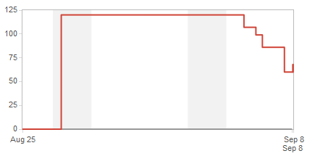
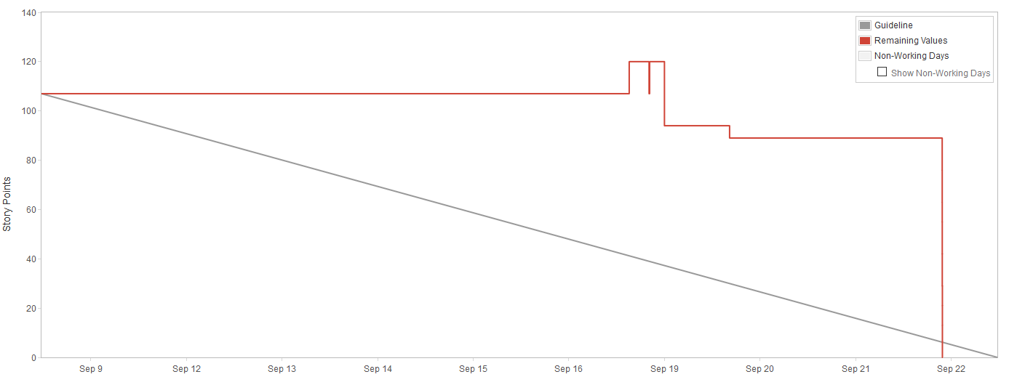
Overview - Burndown Chart (Story Points JIRA)
Sprint 1 Sprint 2

Slide 7
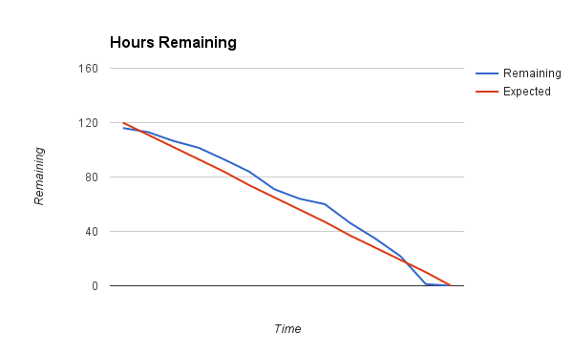
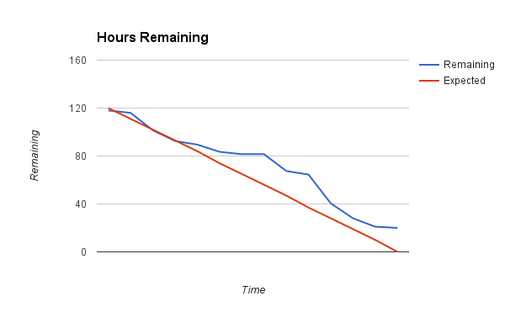
Overview - Hour Burndown Chart (Time Logging)
Sprint 1 Sprint 2

Slide 8
Release V1 Business Values
New and existing Students can see information on services and fees
Students can Register
Students can apply for lessons
Students can Hire Instruments
Teachers can accept students
Managers can Register Teachers and other Managers
Managers can accept Instrument Hire Requests and Return Instruments
Managers can deactivate teacher accounts

Slide 9
Stories: Teacher - Accept Student (AALV-61)
Done:
Create file structure
Create Service to process data
Create Confirmation Page
Test accepting Students
To Do:
Send Confirmation
Changed last Acceptance Criteria - Now shows up to all teachers
Acceptance Criteria:
Able to view students who want to be taught by the teacher.
Able to accept the student
If accepted, time gets booked in teacher + student's schedules
Student and Management gets notified
Able to decline the student (with reason)
If declined, student is informed if they specifically requested the teacher
If declined, management is informed
Teacher request gets sent to another teacher.

Slide 10
Stories: Student - View Lesson Info (AALV-58)
Done:
Create Folder Structure
Create and Style Page
Create Service(s) for Processing Data
Test Student Lesson View
Acceptance criteria changed from initial due to miscomunication
Acceptance Criteria:
List of instruments taught at school
General Information

Slide 11
Stories: Student - Hire an Instrument (AALV-14)
Acceptance Criteria:
Instrument Filtering for a specific instrument
Can't request a borrowed or broken instrument
Once requested, other students are unable to put in a request for the same instrument.
Done:
Create Service(s) for Processing Data
Testing of Instrument Hire

Slide 12
Stories: Manager - Return Instruments (AALV-35)
Acceptance Criteria:
Shows hired out instruments list
Can filter by student/ search for student name
Can mark as returned
Returned instruments show up in the available instrument view
Notify the student that it has been processed
Done:
Create File Structure
Create Service(s) for Processing Data
Test Return Page

Slide 13
Stories: Manager - View Hire Requests (AALV-32)
Acceptance Criteria:
Filter by student/ search by student name
Ability to accept or deny requests
Student is informed
Once instrument is assigned to a student, it must be marked as hired
Done:
Create File Structure
Create Hire Request View Page
Create Service(s) for Processing Data
Test Hire Request View

Slide 14
Stories: Owner - Register Managers (AALV-119)
Done:
Create Folder Structure
Create Manager Registration Form
Create Angular and NodeJS apps
Link Existing Login Service to new Login Form
Test Manager Registration and Login
To Do:
Setup Password Changing
Acceptance Criteria:
Able to enter general details - Name, email, phone, address
Able to create account if details are given produces error if not
Email account details to manager with temp password that needs to be changed on first login
Manager account can log in after creation
Teacher prompted to change password on login

Slide 15
Stories: Student - See Borrowed Instrument Details (AALV-59)
Done:
Create Folder Structure
Create Instrument Information Page
Create Angular & NodeJS apps
Test Borrowed Instruments Page
Acceptance Criteria:
Lists all equipment borrowed by the student
Does not show anything else
Lists accurate due dates for borrowed equipment

Slide 16
Stories: Student - View Hire History (AALV-15)
Done:
Create Folder Structure
Create Instrument History Page
Create Angular & NodeJS apps
Test Instrument History Page
Acceptance Criteria:
Only shows instruments previously hired/currently being hired.
Shows name, ID, type and condition

